Slide 1
Electricity Prices Prediction
Team member
411521104030 : S.Dinesh kumar
411521104017 : J.Deepak
411521104051 : S.Karthi
411521104020 : K.Deepan chakkaravarthi
Phase-1 Document submission
Abstract :
The Electricity Prices Prediction Guidelines offer a structured framework comprising various modules for forecasting electricity prices, a critical task in today's dynamic energy markets. Accurate price predictions are essential for stakeholders ranging from energy providers and consumers to grid operators and policymakers, enabling them to optimize operations, enhance market efficiency, and promote sustainable energy practices.
This abstract provides an overview of the key modules within these guidelines:
Data Preprocessing Module:
This module lays the foundation for reliable predictions by emphasizing the importance of data quality. It guides users through data collection strategies, data cleaning, and preprocessing techniques, ensuring that datasets are suitably prepared for analysis.
Feature Engineering Module:
A fundamental step in electricity price prediction is feature engineering. This module presents methods for selecting pertinent features, transforming data, and incorporating domain knowledge, all aimed at improving model accuracy.

Slide 2
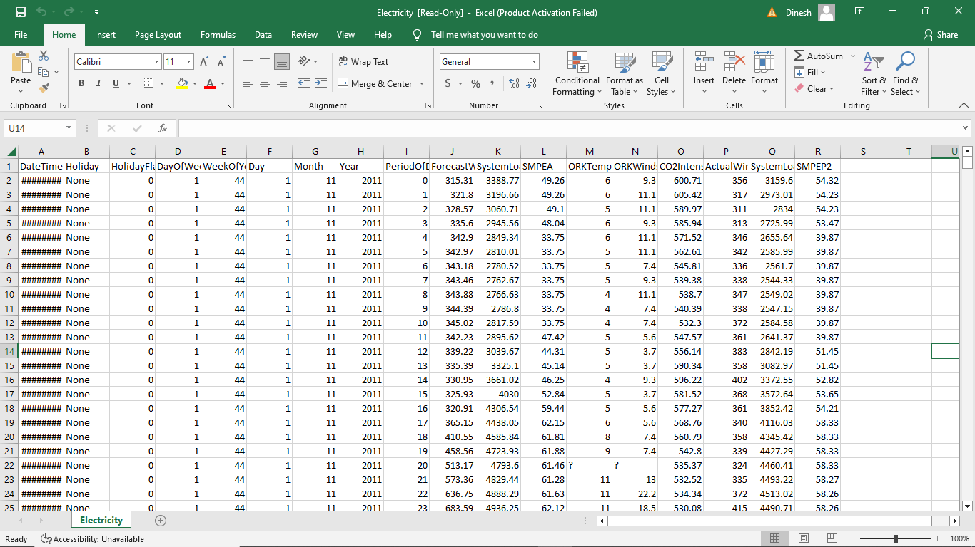
Data sorce:
Model Selection and Tuning Module:
Addressing the diverse challenges of electricity price prediction, this module explores various modeling approaches. It assists users in selecting appropriate algorithms and optimizing model parameters to enhance predictive performance.
Evaluation and Validation Module:
Robust model assessment is essential. This module provides guidance on choosing suitable evaluation metrics, designing effective validation procedures, and conducting rigorous model testing and validation.

Slide 3
Uncertainty Quantification Module:
Recognizing the inherent unpredictability in electricity markets, this module introduces techniques for quantifying and managing uncertainty. It ensures users can account for and mitigate risks associated with price predictions.
Ethical Considerations Module:
Ethical considerations are paramount in predictive modeling. This module highlights issues related to fairness, transparency, and privacy, offering guidelines to ensure responsible and equitable use of predictive models in energy markets.
Case Studies and Best Practices Module:
Practical application is facilitated through real-world case studies and best practices. This module showcases how the guidelines are implemented successfully in diverse electricity markets, aiding users in understanding and replicating the process.

